Slide 1
Micro-CreditDefaulter Model
Use Case

Slide 2
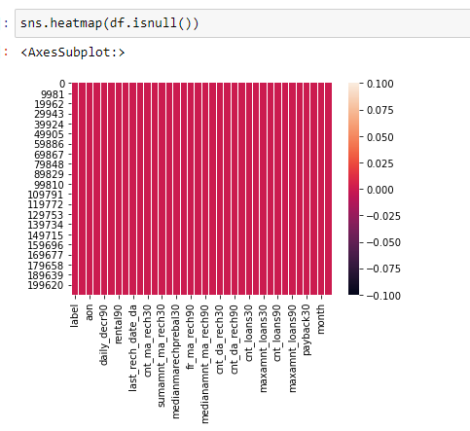
Heat Map Plot

Slide 3
Obervation
From Heat Map check the missing value .
White strip shows for zero value present in Dataset

Slide 4
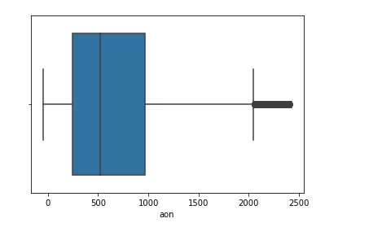
Box Plot
Using Box plot check outliers

Slide 5
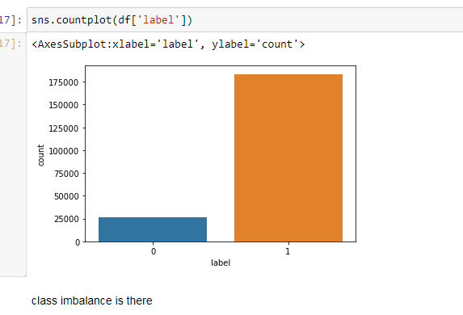
Class Imbalance
Shows class imbalance using count plot (Label is Target columns in categorical from 1 and 0 : . Non- defaulter : Defaulter)

Slide 6
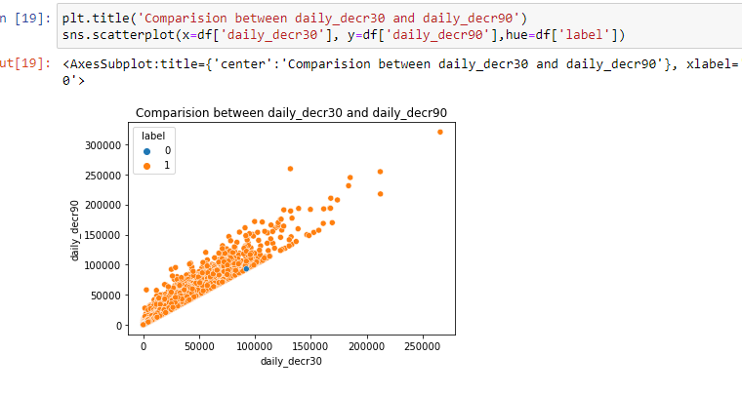
Scatter Plot
Using Scatter plot shown comparison between two columns and rate of success is more showing in orange color

Slide 7
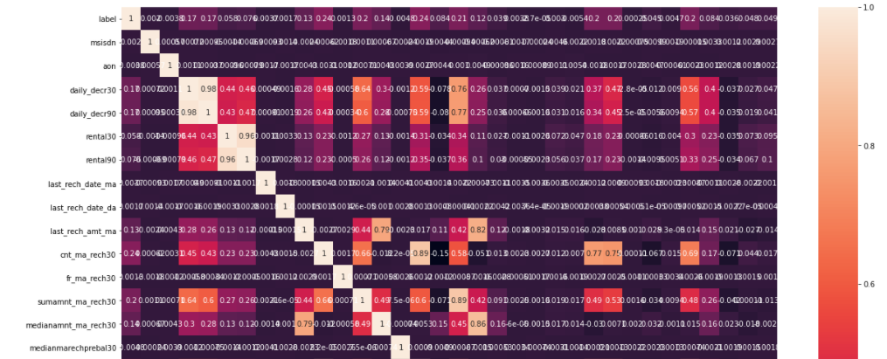
Cor-Relation Matrix
Plot show the relation between the columns

Slide 8
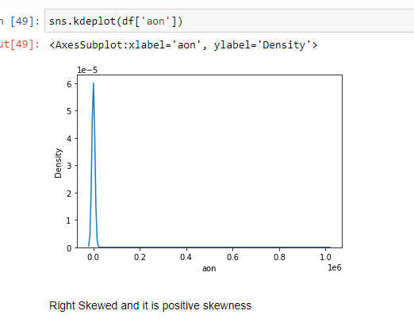
Kde Plot KDE represents the data using a continuous probability density curve in one or more dimensions
Data is Right Skewed more so have to remove some skewness and it is because of outliers present in dataset

Slide 9
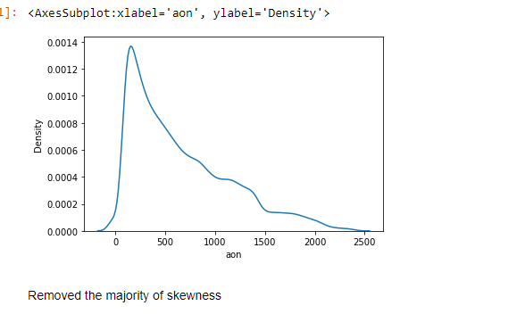
Plot After Remove the majority of Skewness

Slide 10
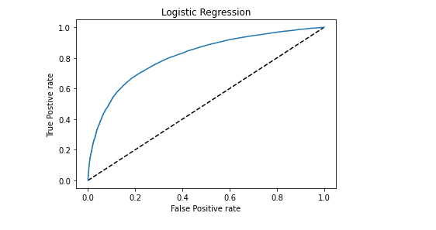
Auc Roc Plot

Slide 11
Thank You

